Slide 1
Message Brokers
Programming Palli

Slide 2
Introduction to Message Brokers
A message broker is software that enables applications, systems, and services to communicate with each other and exchange information.
The message broker does this by translating messages between formal messaging protocols.
This allows interdependent services to “talk” with one another directly, even if they were written in different languages or implemented on different platforms.

Slide 3
Message Broker Models
Producer or publisher is the message sender
Consumer or subscriber is the message recipient
Message queue is where a message is routed to

Slide 4
Types of Messaging Models
Even though there are several message broker models we will discuss the main two types.
Point-to-Point.
Publish-Subscribe.

Slide 5
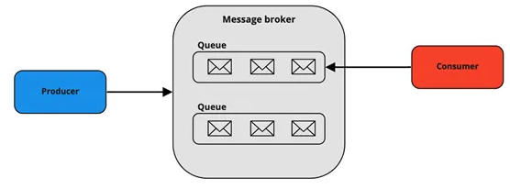
Point-to-Point
Message queues have a one-to-one relationship with the message’s sender and receiver.
Each message in the queue is only sent to one recipient and is received only once.

Slide 6
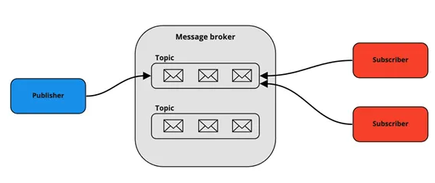
Publish-Subscribe
This message model is known as pub/sub.
Message queues have a one-to-many relationship.
This model can be used for a system where data should be shared among several parties constantly.
Example: Order, Inventory.

Slide 7
When should I implement
Microservices.
Long-running tasks.
Mobile App Notification.

Slide 8
Advantages
Message delivery is guaranteed — Even though the consumer was not active or offline the message will deliver when active.
System performance is increased with asynchronous processing — Processes that take a long time can be processed separately and therefore the main thread of the application will not be affected.
Applications to communicate with each other, even if they are implemented in different programming languages — (Ex: SOAP, REST API, IoT devices etc).

Slide 9
Popular Message Brokers
RabbitMQ.
Kafka.
ActiveMQ.

Slide 10
Question?

Slide 11
Thank You
Please subscribe

